Slide 1
Data Engineering 2 Project
New York taxi Dataset
Karthikeya Sharma (11018760)
Aditya Raj Singh (11018674)
Mohammadreza Yazdankhah (11026643)

Slide 2
Introduction
The dataset contains records of taxi trips, capturing various attributes and measurements related to each trip. This dataset can be utilized for diverse analytical purposes within the transportation domain. It encompasses information such as pickup and drop-off timestamps, trip distances, fare amounts, payment types, and tipping amounts.

Slide 3
Dataset Used
We have used New York Taxi Data
https://www.nyc.gov/site/tlc/about/tlc-trip-record-data.page
Streaming Data – We have consumed data directly from an API and loaded it into database using Kafka and Python.
Batch Data – We have used the parquet format files available in their website and then converted them to CSV using Python script.

Slide 4








Lambda Architecture
Speed Layer
Batch Layer

Slide 5
Reasons to use lambda Architecture
Real-time and Batch Processing
Flexibility and Scalability
Fault Tolerance and Resilience
Future-Proofing
Flexibility in Choosing Technologies
Optimized Processing Paradigms
Robustness and Data Consistency

Slide 6
Streaming Data Flow
New York Taxi API was generated and passed into Kafka
Kafka was used as a buffer storage. Producer was used to collect and send data from the API to Kafka topic. Consumer will process the real time data received from topic and integrate with MySQL database
Python was used as a medium to set up Kafka environment and was also used to convert the data from API to a format in which the Kafka producer could consume the data.
We used MySQL as the database layer to store the real time data that we received from Kafka Consumer and was also connected to tableau using SQL Connector.
Tableau is the presentation layer of our project, to Visually showcase the result.

Slide 7
Batch Data Flow
Files were taken from New York Taxi official website, which were in Parquet format
Python was used to convert Parquet files to CSV files
After conversion , we have the taxi data ready to export into MySQL in CSV format.
Tableau Prep was used to clean and merge the data and import it into MySQL.
We have used MySQL as our Database layer.
Finally, Tableau was implemented to Run Aggregated SQL queries and Visualize the Data.

Slide 8
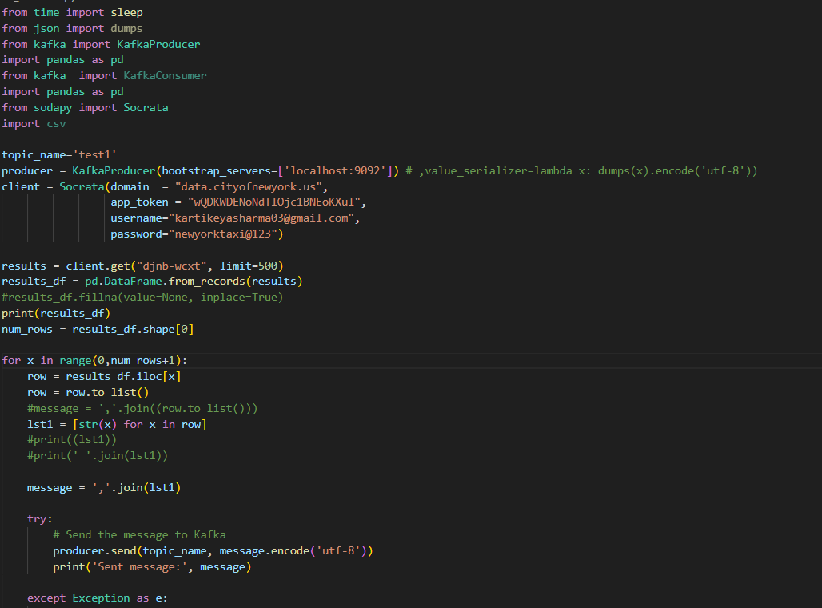
Streaming Flow Code Snippets
Kafka Producer

Slide 9
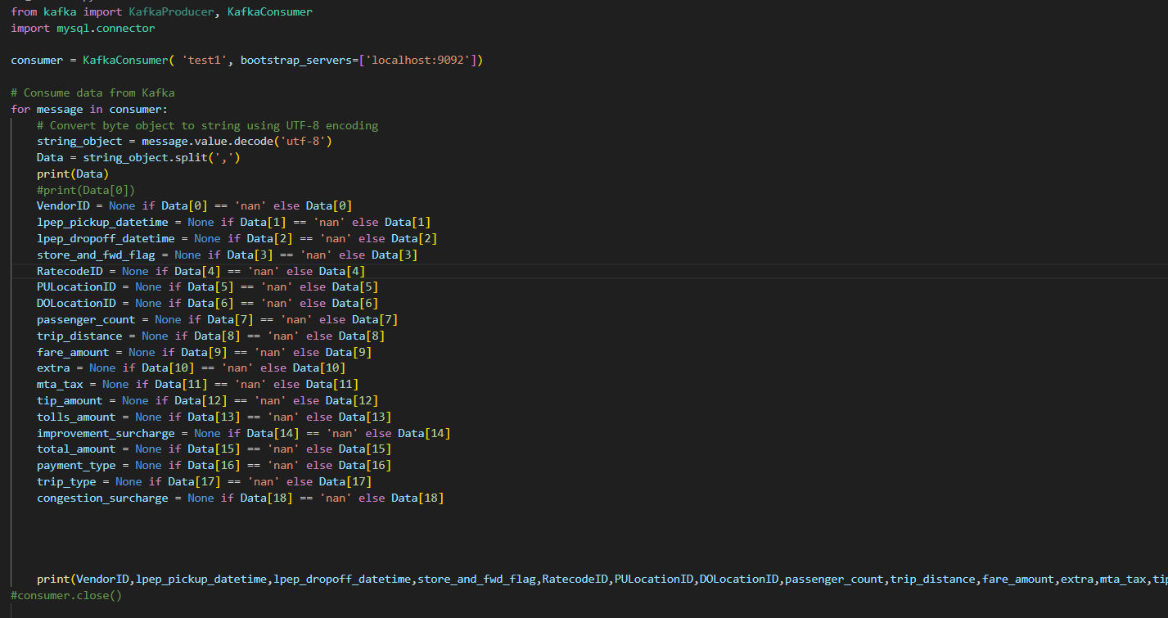
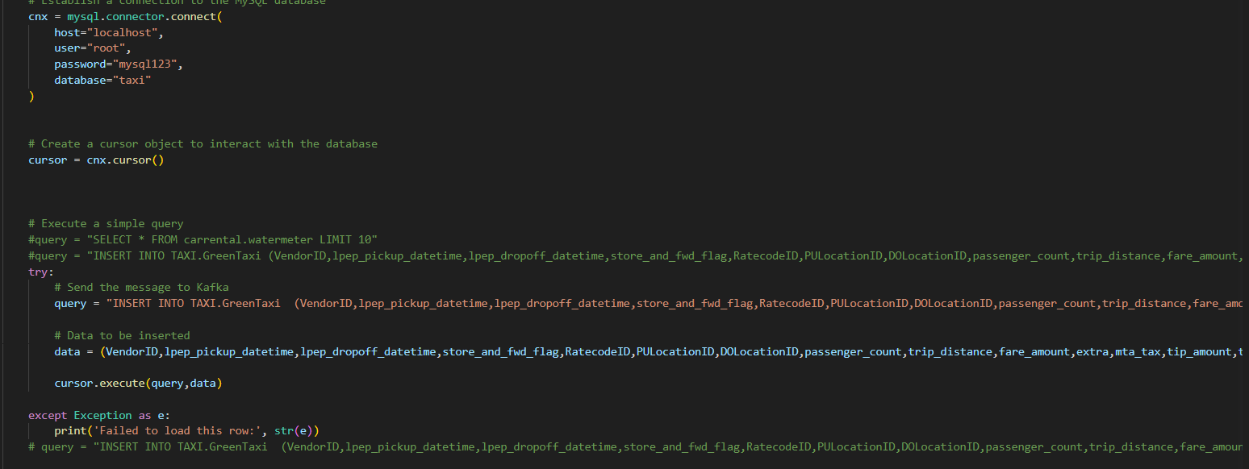
2. Kafka Consumer

Slide 10
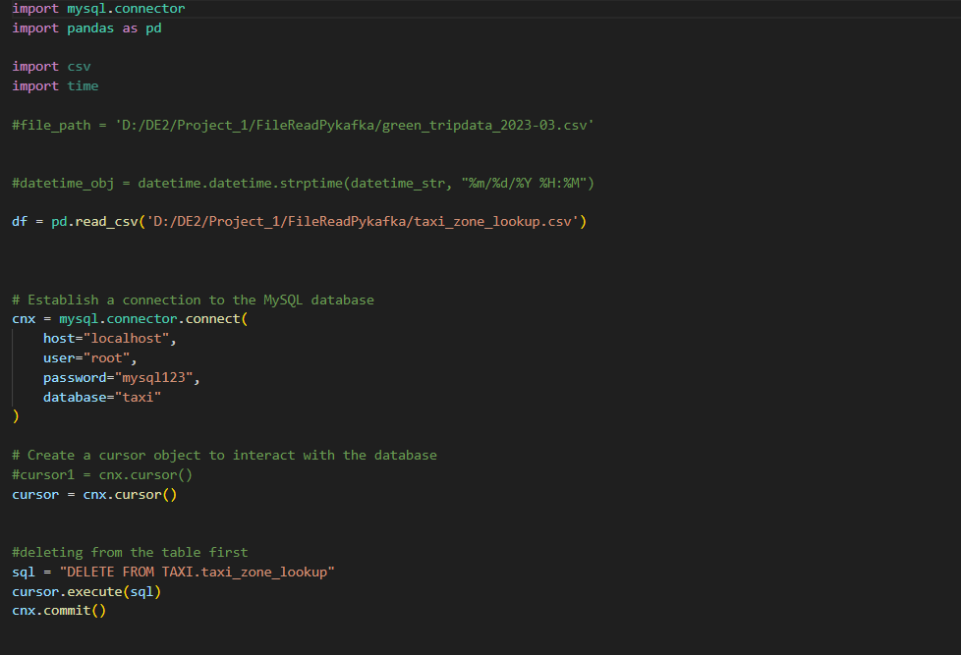
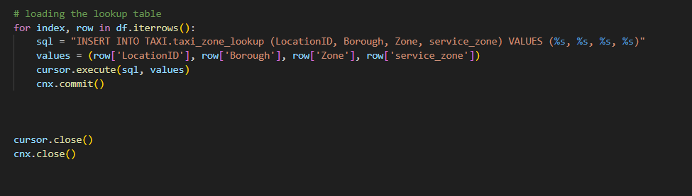
3. Loading Taxi Look up table

Slide 11
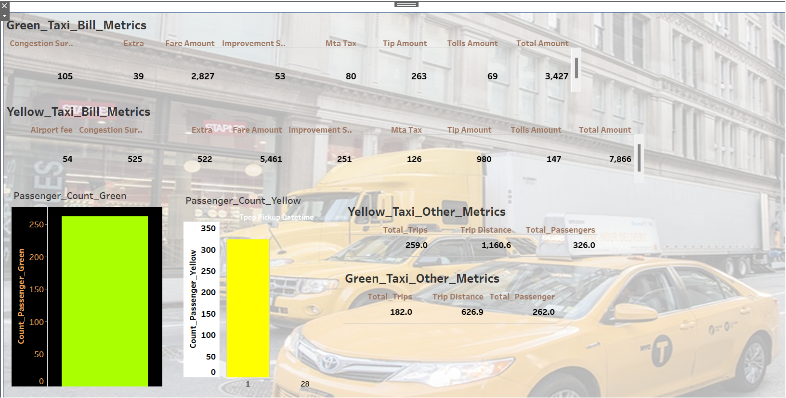
4. Tableau Streaming Dashboard

Slide 12
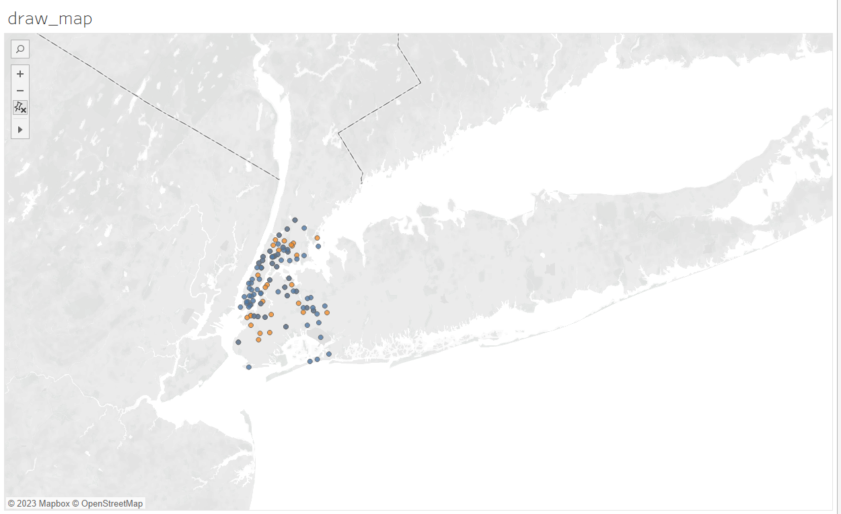
5. Tableau Streaming Map Dashboard

Slide 13
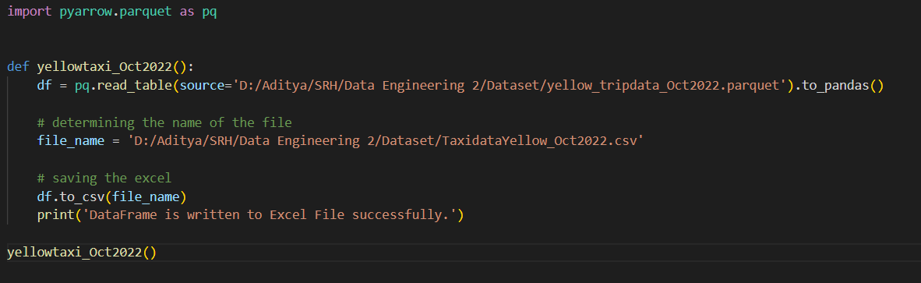
Batch Flow Code Snippets
Conversion of parquet file to CSV using Python
We have used pyarrow.parquet to convert parquet file to csv file. We have considered 3-month data for both Yellow and Green Taxi.

Slide 14
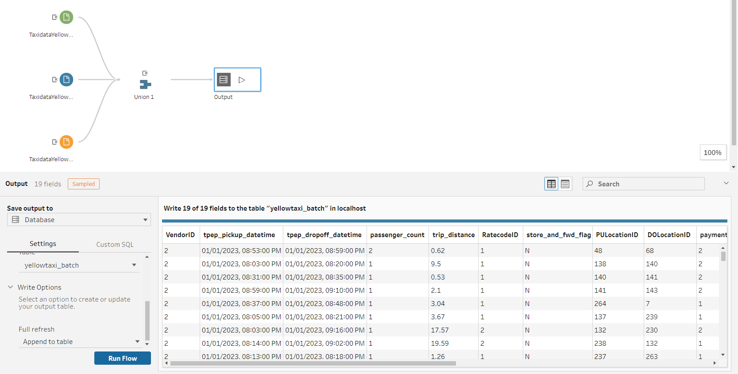
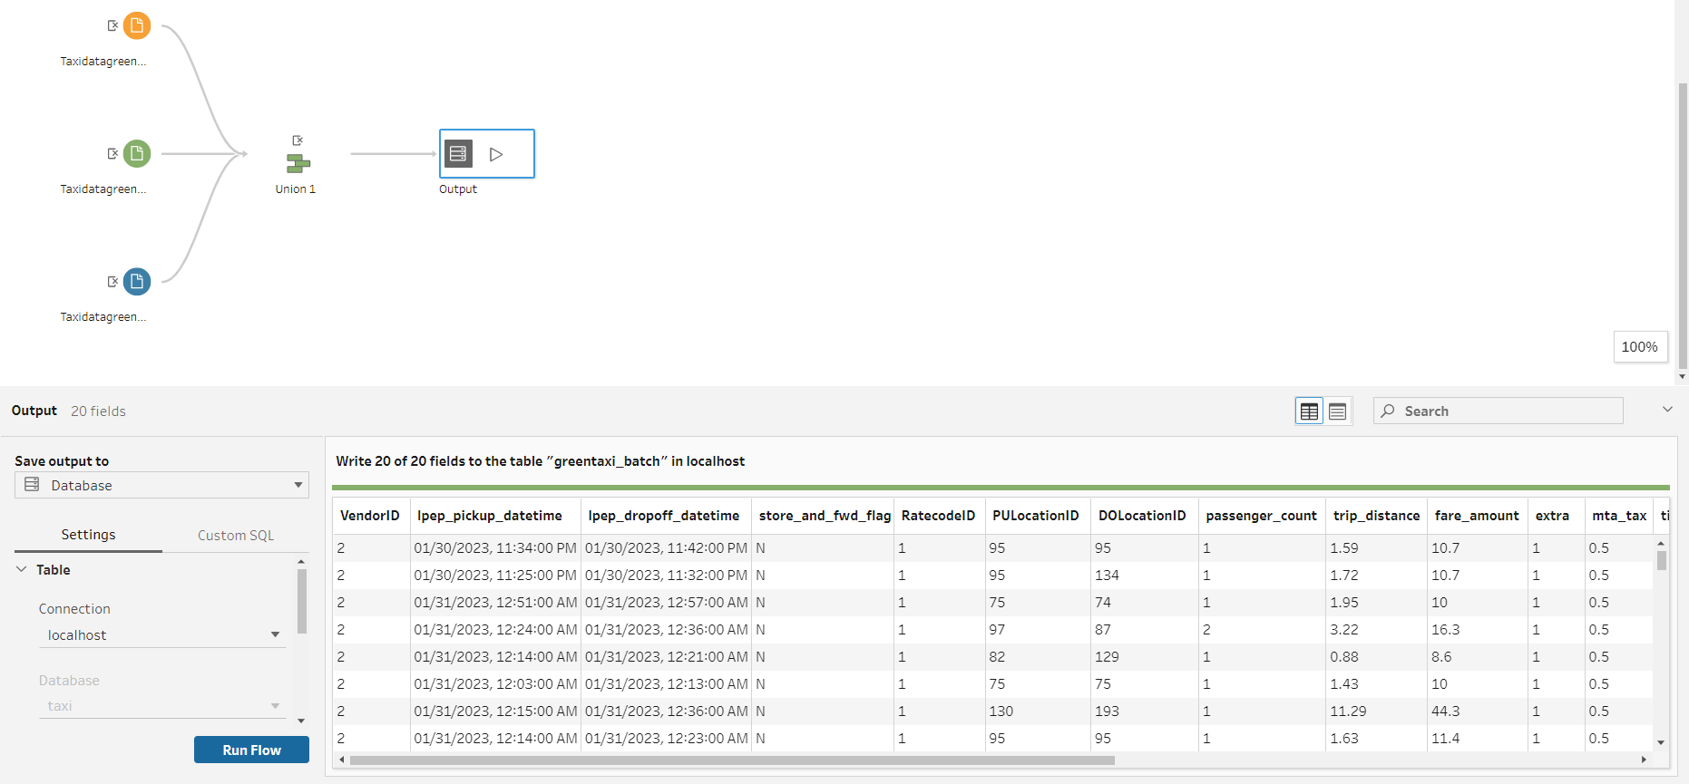
Merging and Loading the data to MySQL
We initially used a python script to merge the 3-month data and load it into MySQL but it was time consuming, so we produced an Idea to use Tableau prep builder and load the data into MySQL.
Yellow Taxi data has more than 3 million rows and Green Taxi data has 250k+ rows.

Slide 15
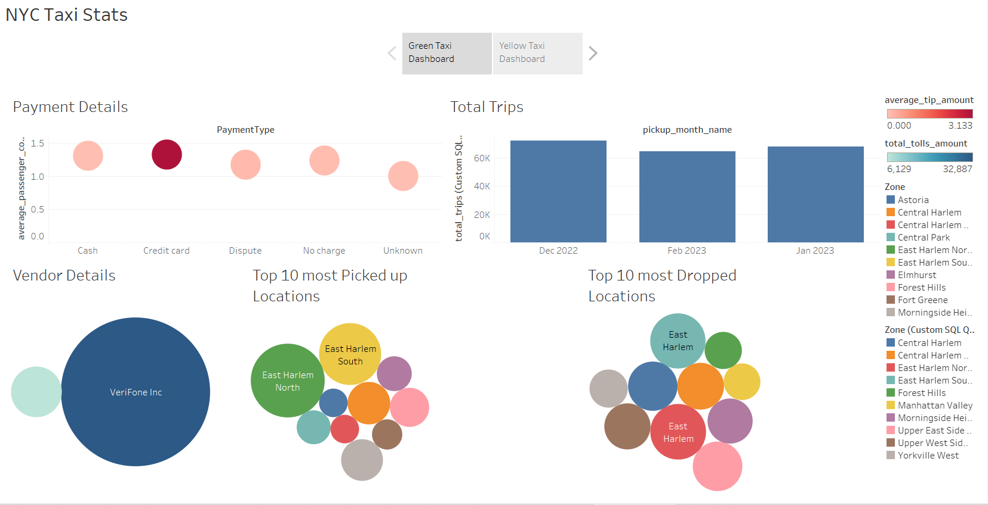
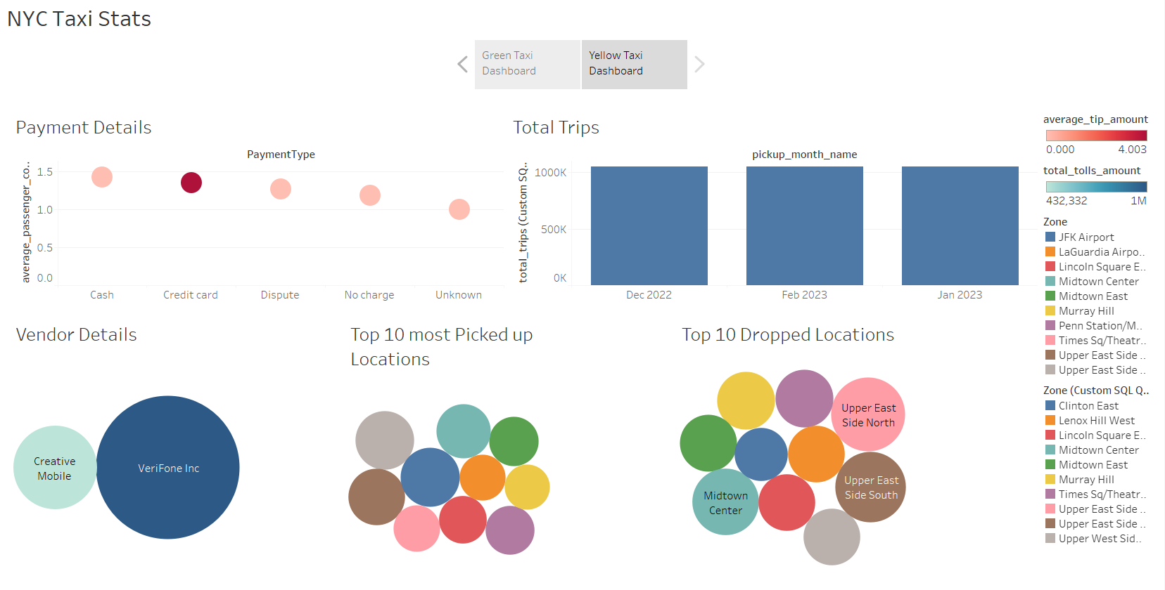
3. Following aggregated SQL Queries were executed in Tableau and created a dashboard for both Yellow and Green Taxi.
Yellow Taxi Dashboard
Green Taxi Dashboard

